Slide 1

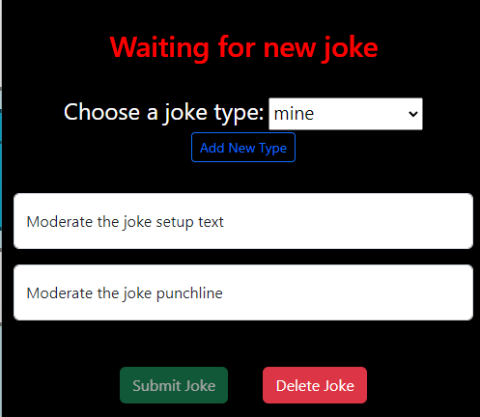
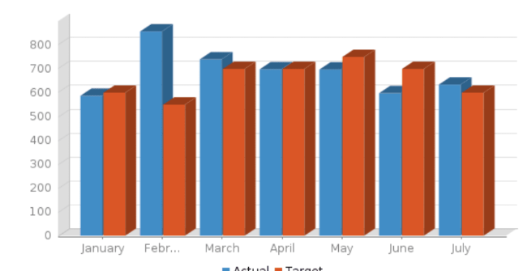

Vnet
Public internet
Azure private network
public IP:
private IP:
Kong
Docker private network
Virtual machine
Application container
Rabbitmq container
4000
4200
joke
submit
/types
3000
3100
4002
MySQL
4202
rmq-admin
3306
mysql
vol
15672
4201
New Joke
msgs
NEW_JOKES
5672
public IP:
private IP:
public IP:
private IP:

